Slide 1

Experiment 1 Linear regression
Acknowledge to: Guoqiang Zhong
Organizers: Guoqiang Zhong, Zhaoyang Niu
Machine Learning Research Group
Ocean University of China
Qingdao, China

Slide 2
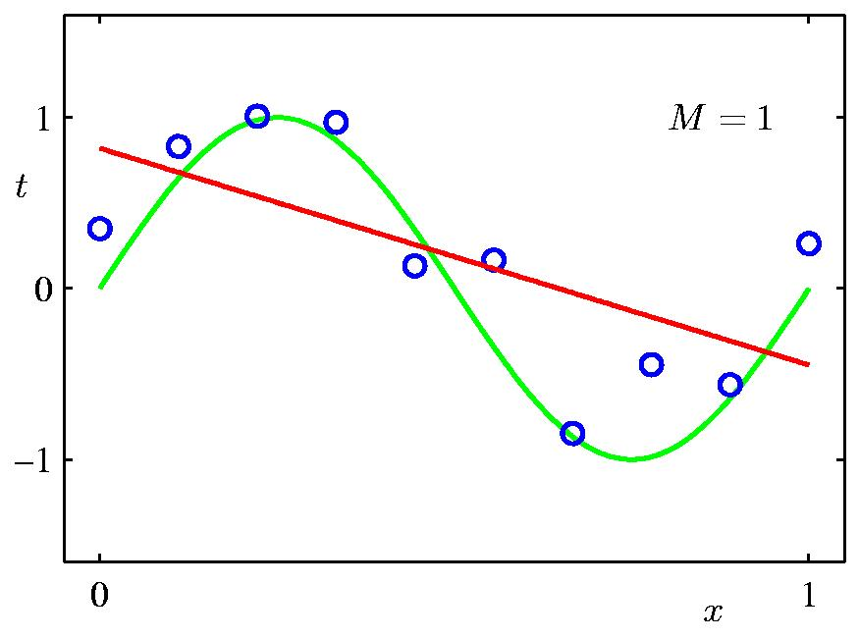
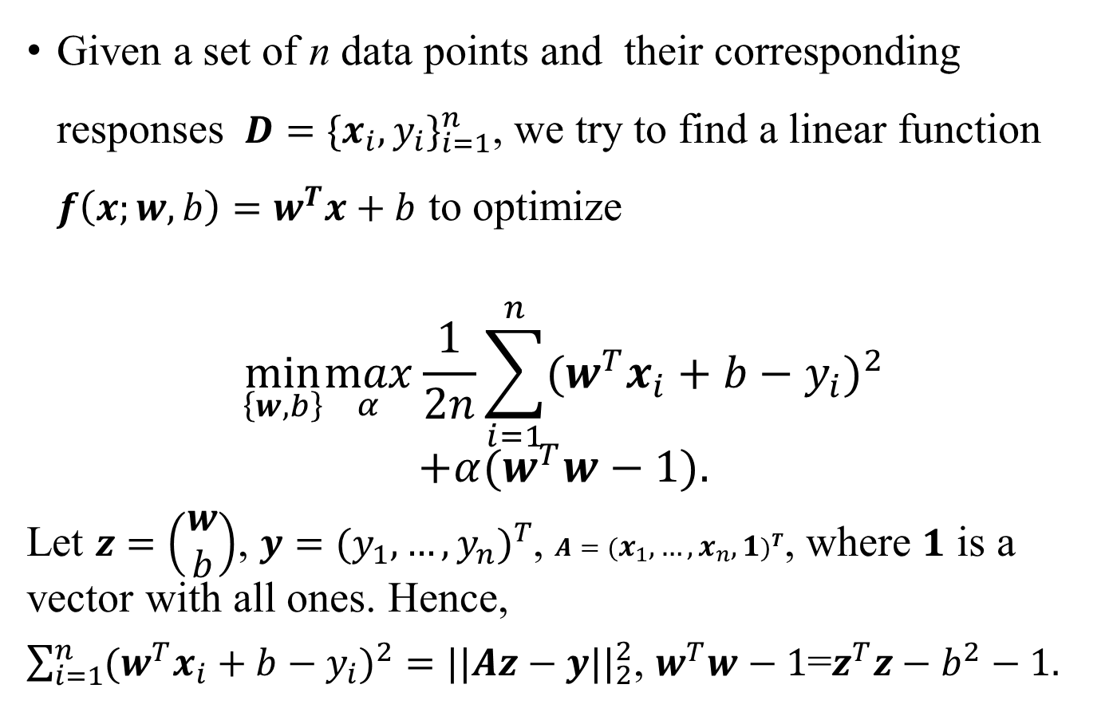
Linear Regression
Given a set of n data points and their corresponding responses $D={{\{x}_{i}, y_{i}\}}_{i=1}^{n}$, we try to find a linear function $f\left(x;w,b\right)=w^{T}x+b$ to optimize
$$\min_{\left\{w,b\right\}}\max_{α}\frac{1}{2n}\sum_{i=1}^{n}{{(w^{T}x_{i}+b−y_{i})}^{2}}$$
$$+α(w^{T}w−1).$$
Let $z=\left(\begin{matrix}w \\ b\end{matrix}\right)$, $y={(y_{1},…,y_{n})}^{T}$, $A={(x_{1},…,x_{n},1)}^{T}$, where $1$ is a vector with all ones. Hence,
$\sum_{i=1}^{n}{{(w^{T}x_{i}+b−y_{i})}^{2}}={||Az−y||}_{2}^{2}$, $w^{T}w−1$=$z^{T}z−b^{2}−1.$

Slide 3

Experiment
Download a regression dataset from UCI machine learning repository (https://archive.ics.uci.edu/ml/datasets.php).
Write the Python code of linear least squares to solve the linear regression problem.
Submit your compressed code, result and report in one week to DL2021Spring@163.com. The code should be reproducible, the result includes mean square error, visualization and that for analysis, while the report introduces the detailed process of your experiments.

Slide 4
Thank you!

